Slide 1
Agenda & Objectives
Agenda
Overview where data modeling fits within SDLC
Define data modeling components
Write business rules
Practice modeling various relationships
Objective
Given an existing entity relationship diagram (ERD), you will be able to create the corresponding business rules.
Given an existing entity relationship diagram, you will be able to describe the business process.
Resource
BusRules_InterpretingERD.pptx

Slide 2
STRUCTURING SYSTEM REQUIREMENTS: CONCEPTUAL DATA MODELING
IS 310
Dr. Jean A. Pratt
Text/visual support from Valacich, George, Hoffer (© 2006 Prentice-Hall, Inc. ); Dennis, Wixom, Roth (© 2006 John Wiley & Sons, Inc.); Dr. Bruce Lo

Slide 3
Creating Business Rules; Interpreting ERDs
Data Modeling

Slide 4
Outline
Overview of data modeling
Deliverables of data modeling
Questions to ask when gathering information
Where data modeling maps to process modeling
Elements of ERD
Cardinality, participation
Degree of relationships
Identifying or non-identifying PK?

Slide 5
Overview of Data Modeling
A model that captures the overall structure of organizational data, independent of DBMS and without implementation details
Deliverable
Entity Relationship Diagram

Slide 6
Gathering Information Questions for Data Modeling
1. What are subjects/objects of the business?
* Entities
2. What unique characteristic distinguishes each object from other objects of the same type?
* Primary key
3. What characteristics describe each object?
* Attributes
4. How do you use this data?
* Reports (via queries) * Security controls (e.g., login requirements)

Slide 7
Questions (cont’d…)
5. How many instances of one entity participate with another entity?
* Cardinality
6. Is participation between entities required or optional?
* Participation
7. What events occur that imply associations between various objects?
* Relationships
8. Is each activity or event always handled the same way or are there special circumstances?
* Integrity rules and triggers

Slide 8
Outline
Overview of data modeling
Elements of ERD
Entity
Attribute
Identifier/Primary Key
Relationships and Business Rules
ERD Notations: Chen and Crow’s Foot
Cardinality, participation
Degree of relationships
Identifying or non-identifying PK?

Slide 9
Entity
A person, place, object, event or concept in user environment about which the organization wishes to maintain data
E.g., employee, student, warehouse, car, sale, booking, account, course
Note the difference
Entity
Entity instance

Slide 10
Attribute
A property or characteristic of an entity of interest to the organization
Many CASE tools do not include attributes on the ERD to avoid cluttering the diagram, but define them in the repository
E.g., STUDENT (Stud_Id, Stud_name, Address, Phone)
E.g., AUTOMOBILE (Vehicle_Id, Color, Horsepower, Year)
Candidate Key
An attribute (or combination of attributes) that uniquely identifies each entity instance
Identifier/Primary Key
A candidate key that has been selected to index the entity

Slide 11
Relationship
An association between entity instances in one or more entities
Defined by business rules

Slide 12
Business Rules
Business Rules rule
How things work here
Start with a single instance of each entity
Always stated in pairs—define relationship from perspective of each related entity
Become the verbs in the relationships
Determine cardinality and participation
The basis for stored procedures and triggers

Slide 13
Examples: Business Rules
Each customer can place many orders.
Each order is placed by one and only one customer.
A department employs one or more employees.
An employee is assigned to one department.
A customer may purchase multiple products.
A product may be purchased by multiple customers.
A student may enroll for many classes.
A class may have many students enrolled in it.
Identify the entities, cardinality and participation indicated in the above business rules.

Slide 14
ERD Notations
Entity-relationship data model
Expressed as entity-relationship diagrams (ERD)
Different notations
Chen P, 1976, The entity-relationship model-toward a unified view of data, ACM Transactions on Database Systems, Vol 1 (March) pp. 9-36
Teorey, Yang & Fry, 1986, Computing Survey, 18 (2)
Storey, 1991, Data and Knowledge Engineering, 7 p47
We use the “Crow’s foot” notation

Slide 15
ERD Notation: Chen
Entity
Relationships
Attribute
Identifier/PK
Multivalued attribute
Associative entity
Cardinality and Participation:
0..1
0..n or 0..*
1..n or 1..*

Slide 16
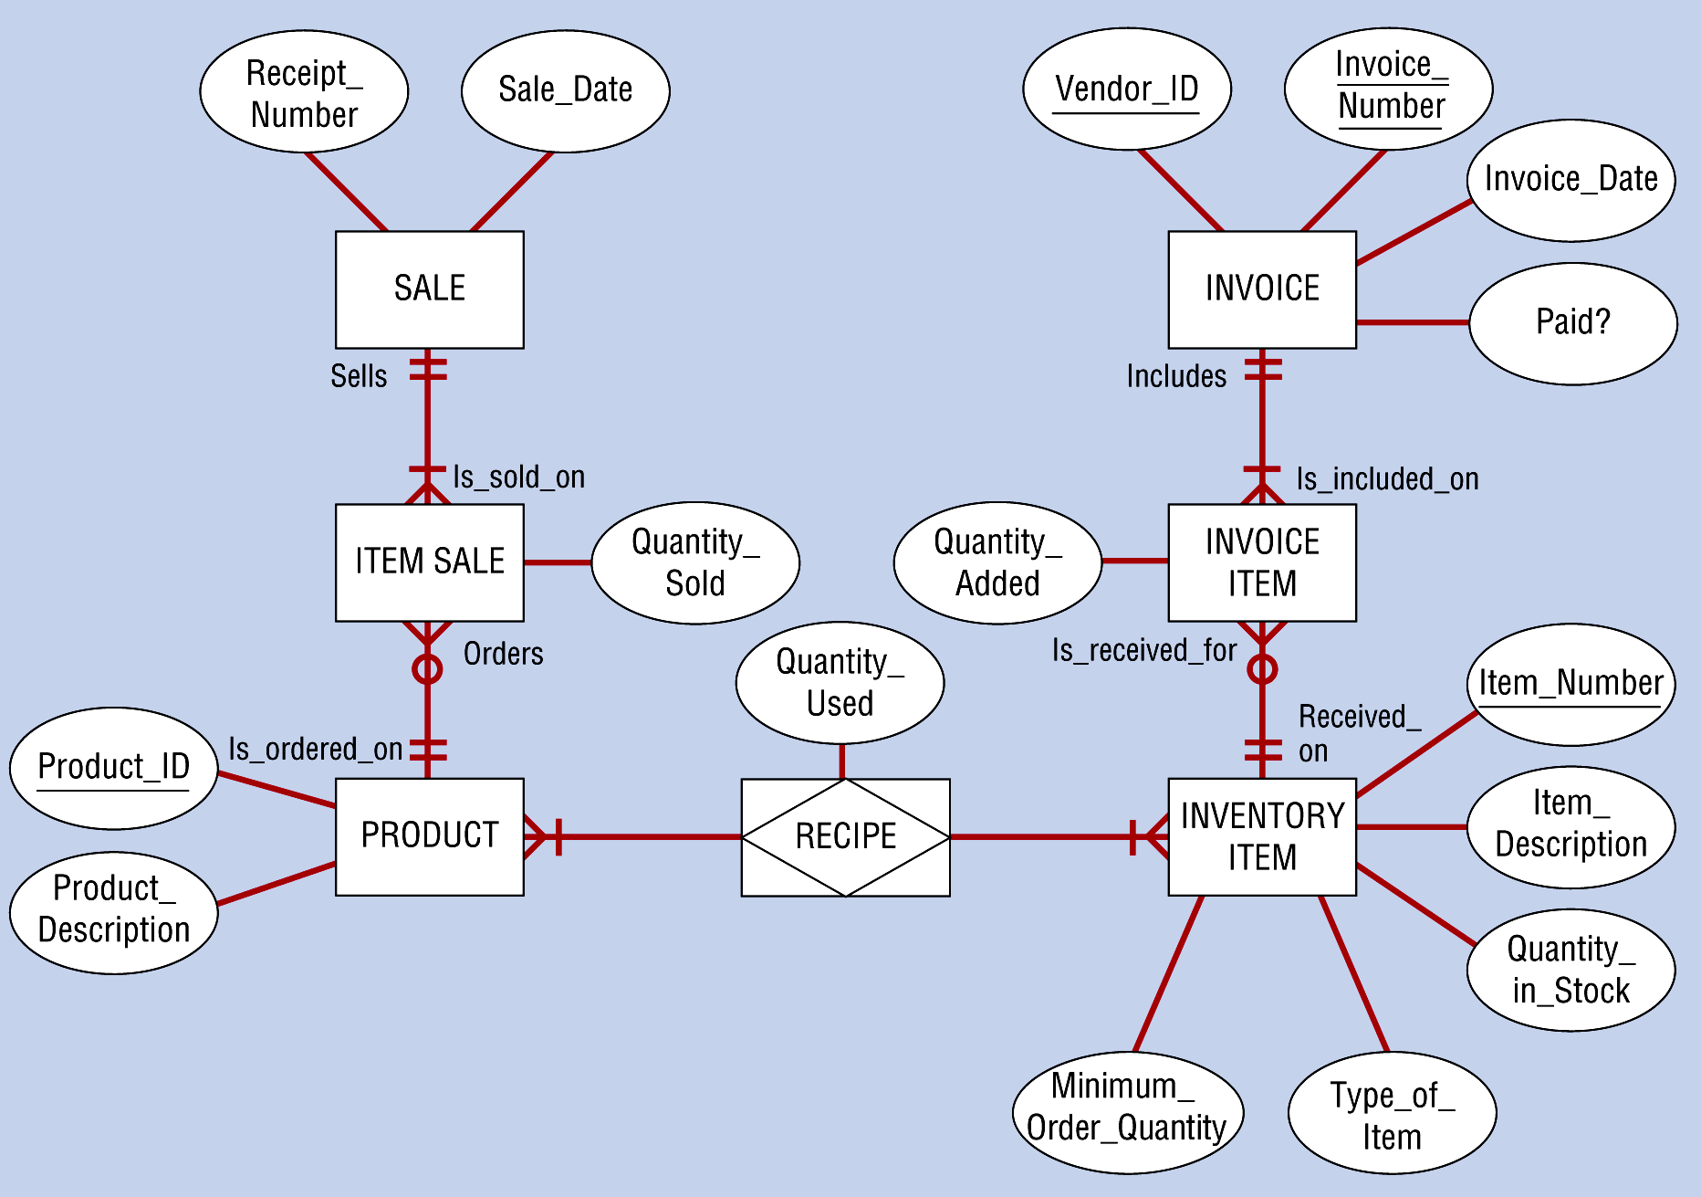
Final E-R Diagram for Hoosier Burger’s Inventory Control System: Chen

Slide 17
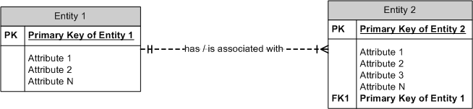
ERD Notation: Crow’s Foot
Cardinality & Participation
Cardinality & Participation
Entity
Unique Identifier
Relationship
Attribute

Slide 18
Outline
Overview of data modeling
Elements of ERD
Cardinality, participation
Degree of relationships
Identifying or non-identifying PK?

Slide 19
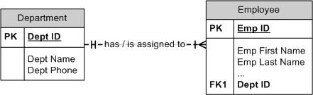
Cardinalities in Relationships
Cardinality = the number of instances of entity B that can (or must) be associated with each instance of entity A.
Cardinality: one or many | or
Department:Employee
A department has one or more employees.
An employee is assigned to one department.
Cardinality is the maximum number (0, 1 or Many) of records in one file that are linked to a single record in another file and vice versa.

Slide 20
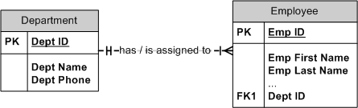
Cardinality Implemented: 1:M
DEPARTMENT
Dept ID | Dept Name | Dept Phone
1000 | Information Systems | 836-1234
1001 | Accounting | 836-2234
1002 | Finance | 836-3234
1003 | Marketing | 836-4234
EMPLOYEE
Emp ID | Emp First Name | Emp Last Name | Dept ID
10 | Joe | Brown | 1001
11 | Jill | Smith | 1001
12 | Bob | Johnson | 1000
13 | Mary | Johansen | 1003
14 | Maxine | Brown | 1000
15 | Guy | Schmidt | 1002
16 | Bob | Black | 1000

Slide 21
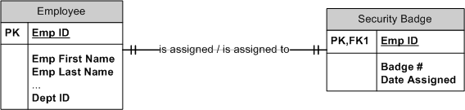
Cardinality Implemented: 1:1
FK
EMPLOYEE
Emp ID | Emp First Name | Emp Last Name | Dept ID
10 | Joe | Brown | 1001
11 | Jill | Smith | 1001
12 | Bob | Johnson | 1000
13 | Mary | Johansen | 1003
14 | Maxine | Brown | 1000
15 | Guy | Schmidt | 1002
16 | Bob | Black | 1000
SECURITY BADGE
Emp ID | Badge # | Date Assigned
10 | A5 | 01/02/2004
11 | A17 | 01/02/2004
12 | B3 | 05/01/2005
13 | C1 | 08/01/2007
14 | A7 | 06/01/2004
15 | D23 | 12/15/2007
16 | B4 | 02/15/2008

Slide 22
Participation in Relationships
Participation: whether or not every instance of one entity must participate in a relationship with another entity (i.e., whether every PK from Entity 1 is a FK in Entity 2); whether or not the FK is required or can be null.
Participation: optional or required O or |
Optional participation
Minimum cardinality is zero
Required participation
Minimum cardinality is one
Participation and Minimum/Maximum Cardinality
If the minimum cardinality is zero, then participation is optional
If the minimum cardinality is one, then participation is required
Maximum cardinality has no effect on participation

Slide 23
Relationship: Crow’s Foot
verb
A
B
verb
verb
A
B
verb
verb
A
B
verb
verb
A
B
verb
verb
A
B
verb
verb
A
B
verb
Notes:
An employee is assigned one parking place; each parking place is assigned to one employee. (Every employee gets a parking place.)
An employee may be assigned one parking place; each parking place is assigned to one employee. (More employees than parking spots—not everybody gets a parking place.)
An employee may be assigned one parking place; each parking place may be assigned to one employee. (An employee doesn’t have to take an available parking place. The employee may not drive to work and doesn’t want to pay for the spot.)
A department may have many employees assigned to it; each employee is assigned to one department. (We can add a new department to the database before assigning employees to it.)
A project may have many employees assigned to it; an employee may be assigned to multiple projects. (We can track employees and projects independently of each other. That is, we can add a new project to the database before assigning employees to it. Always break M:M relationships into two 1:M relationships.)
A project has many employees assigned to it; an employee is assigned to multiple projects. (An employee is working on multiple projects at the same time. Each employee must be assigned to at least one project; a project must have at least one employee assigned to it. Always break M:M relationships into two 1:M relationships.)

Slide 24
What are the business rules?

Slide 25
Outline
Overview of data modeling
Elements of ERD
Cardinality, participation
Degree of relationships
Unary
Binary
Ternary
Identifying or non-identifying PK?

Slide 26
Degree of Relationships
Degree of a relationship
The number of entities that participate in a relationship
Three main types of degrees
Unary relationship: involves only 1 entity
Binary relationship (most common): involves 2 entities
Ternary relationship: involves 3+ entities
Higher is possible but rarely implemented

Slide 27
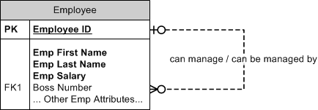
Relationships of Different Degrees: Unary Relationships—1 Entity
Employee:Manager—a 1:M Recursive Relationship
Notice both effects of the optional participation
Employee_ID | First Name | Manager
1 | Heather
2 | Lisa | 1
3 | Maxine | 1
4 | Gertrude | 1

Slide 28
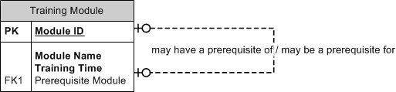
A Unary 1:1 Recursive Relationship
What are the business rules?

Slide 29
Unary 1:1 Recursive Relationship
Module_ID | Module Name | Training Time | Prerequisite Module
A | Beginning Database | 1
B | Intermediate Database | 1.5 | A
C | Advanced Database | 3 | B
D | Beginning Modeling | 1
E | Intermediate Modeling | 1 | D
F | Advanced Modeling | 3 | E
G | Beginning SQL | 2
H | Intermediate SQL | 5 | G

Slide 30
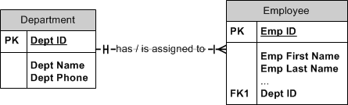
Relationships of Different Degrees: Binary Relationship—2 Entities

Slide 31
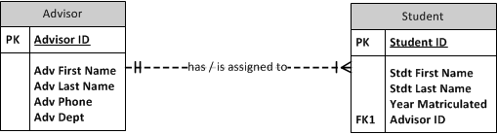
Binary 1:M Relationship
What are the business rules?

Slide 32
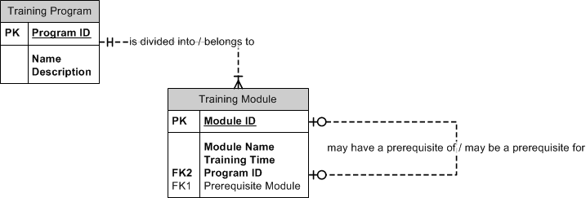
Binary 1:M Relationship
What are the business rules?

Slide 33
Binary 1:M Relationship
Module_ID | Module Name | Training Time | Prerequisite Module | Program ID
A | Beginning Database | 1 |  | 1
B | Intermediate Database | 1.5 | A | 1
C | Advanced Database | 3 | B | 1
D | Beginning Modeling | 1 |  | 2
E | Intermediate Modeling | 1 | D | 2
F | Advanced Modeling | 3 | E | 2
G | Beginning SQL | 2 |  | 3
H | Intermediate SQL | 5 | G | 3

Slide 34
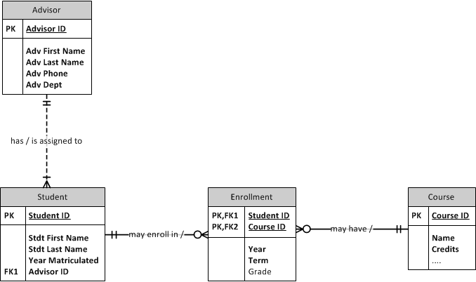
Binary M:M Relationship
What are the business rules?

Slide 35
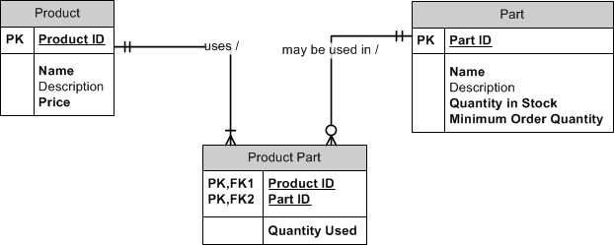
Demo: Binary M:M Relationship
Product:Part
A part may be used in multiple products.
A product uses multiple parts.

Slide 36
Binary M:M Relationship
Product_ID | Part_ID | Qty Used
1551 | 234 | 2
1551 | 567 | 5
1551 | 369 | 1
1552 | 234 | 1
1552 | 900 | 1
1553 | 567 | 2
1553 | 678 | 4

Slide 37
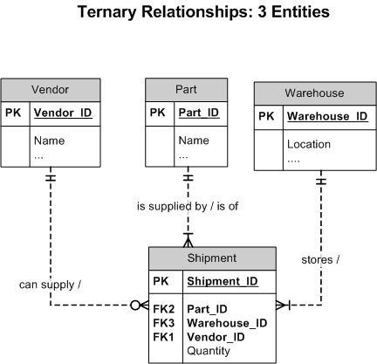
Ternary Relationships
What are the business rules?

Slide 38
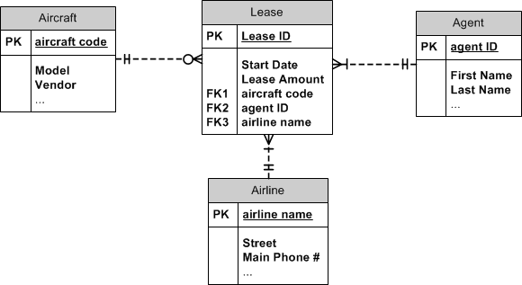
Ternary Relationships
Ternary Relationships: 3 Entities
What are the business rules?

Slide 39
Outline
Overview of data modeling
Elements of ERD
Cardinality, participation
Degree of relationships
Identifying or non-identifying PK?

Slide 40
Identifying/Non-identifying PK?
Purpose of the Primary Key is to uniquely identify each row in the table.
Rules for creating PK:
Must uniquely identify each row
Value will not change
Will not have a NULL value
Is the least amount of fields that will satisfy the above
Identifying relationship
PK of one entity includes the PK of another entity
Non-identifying relationship
PK of an entity is independent of other entities

Slide 41
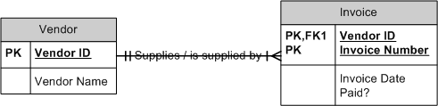
Identifying/Non-identifying PK?
Which entity is strong/independent/non-identifying?
Which entity is weak/dependent/identifying?

Slide 42
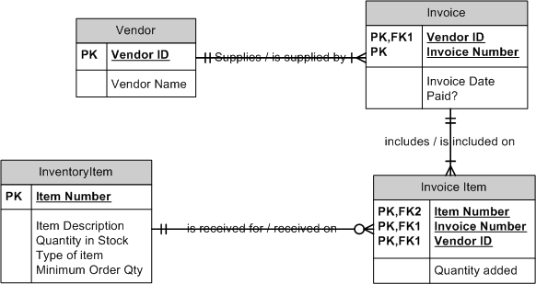
Identifying/Non-identifying PK?
Although technically correct, what is an inherent problem in identifying relationships?

Slide 43
Review: What you Know
How data modeling fits with process modeling
How to define and identify each element in a data model
How to interpret unary, binary and ternary relationships in data models
How to avoid data modeling problems

